Slide 1


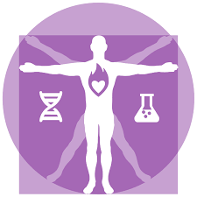

University of Basrah
Al-zahraa medical college
Ministry of higher education and scientific research
Ministry of higher Education and Scientific Researches
The module: Metabolism
Session 5, Lecture 1
Duration: 2 hrs
Lipid metabolism and transport
Module staff:
Dr.Douaa Saadi Salim Dr. Zainab Muzahim
Dr. Amani Naama Dr. Ammar Mohammed Saeed
‎ Dr. Zainab Almnaseer Dr. Israa Mazin
Dr. Hamid Jaddoa Dr. Laith Anmar
Dr. Noor Ibrahim Dr.Noora Lefta
Dr. Maida Abdulaa Adnan Dr.Ahmed Abbas
Ass. Lec. Eatidal Akram Ass.Lec.Ibrahim Ayad
1.Harper's Illustrated Biochemistry, Thirtieth Edition Copyright © 2015
2. Lehninger Principles of Biochemistry Sixth Edition (6th Edition)
3. Marks Essentials of Medical Biochemistry.

Slide 2
Learning outcomes
At the end of this lecture you should be able to:
1-Explain how, when and why ketone bodies are formed. LO1
2-Describe how lipids are transported in the blood. LO2
3- Explain how tissues obtain the lipids they require from lipoproteins. LO3
4-How clinical problems related to lipids transport defects. LO4
5- Analyse simple problems that involve disturbances to lipid transport. LO5
6-Explain how hyperlipoproteinaemias may be treated. LO6

Slide 3
LO1
Ketone bodies are three water-soluble molecules: acetoacetate, beta-hydroxybutyrate, and acetone.
They serve as alternative energy sources when the body's primary fuel (glucose) is limited.
When the body needs energy but doesn't have enough glucose, it breaks down stored fats into fatty acids.
In the liver, these fatty acids are converted into ketone bodies through a process called ketogenesis.
What Are Ketone Bodies?

Slide 4
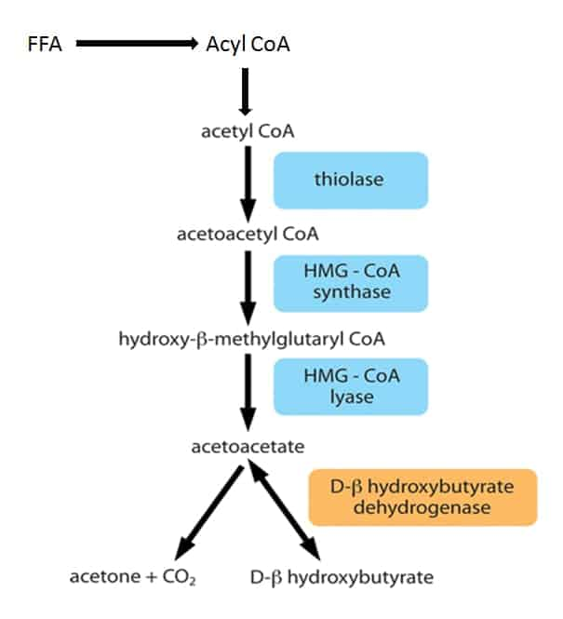
Ketone bodies synthesis
LO1

Slide 5
so ketone bodies synthesis require:
1- fatty acids to be oxidized in the liver
( substrate).
2- low plasma insulin/glucagon ratio ( activates the lyase enzyme).
LO1

Slide 6
What happens when insulin/glucagon ratio is high ???
LO1
Activates reductase & inhibits the lyase enzyme
Stimulate cholesterol synthesis

Slide 7
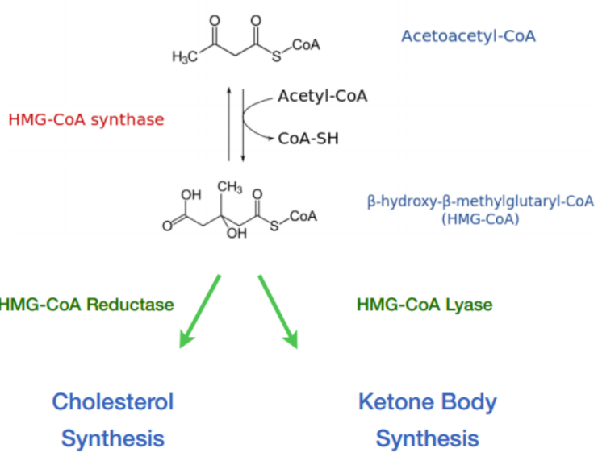
LO1

Slide 8
LO1
Ketone bodies provide an efficient energy source for many tissues, including the brain, when glucose is limited, for examples in fasting, prolonged exercise & low-carbohydrate diet.
However, excessive ketone production can lead to a condition called ketosis, which, in extreme cases, may result in ketoacidosis—a dangerous drop in blood Ph.

Slide 9
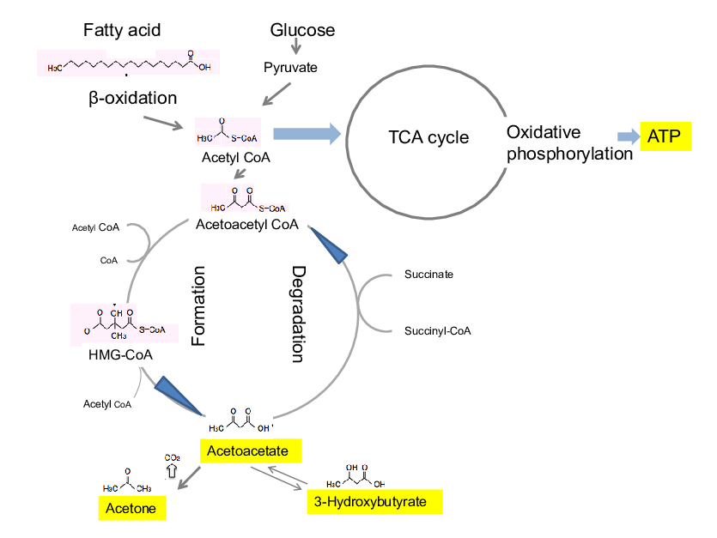
LO1

Slide 10
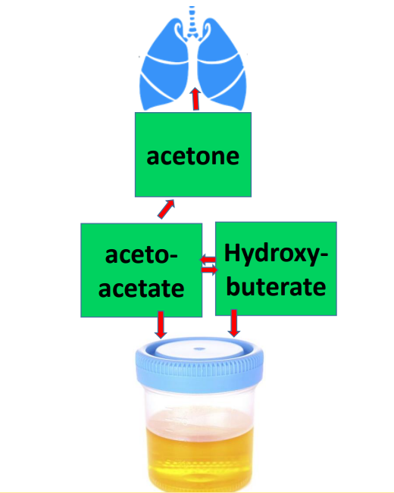
LO1

Slide 11
Lipid transport
LO2
Various classes of lipids including triacylglycerols, fatty acids, cholesterol, cholesterol esters and phospholipids are normally present in blood.
They come from the diet or synthesized in the body.
Then transported to tissues for storage or utilization.
but they are water insoluble, so how can the body overcome this problem ????????!!

Slide 12
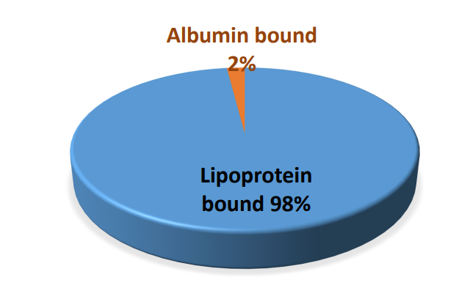
LO2
98% of the lipids are tranported via lipoprotein.
2% of the lipid (mostly F.A) are carried bound non-covalently to albumin.

Slide 13
lipoprotiens
LO2
Are spherical soluble protein complexes
The water-soluble (polar) groups of proteins, phospholipids and free cholesterol face outwards and surround an inner insoluble (non-polar) core of triglyceride and cholesterol ester.
The protein components are specific proteins that called apoproteins which they have functional role(like activation of enzymes, recognition of cell surface receptors) as well as structural roles.

Slide 14
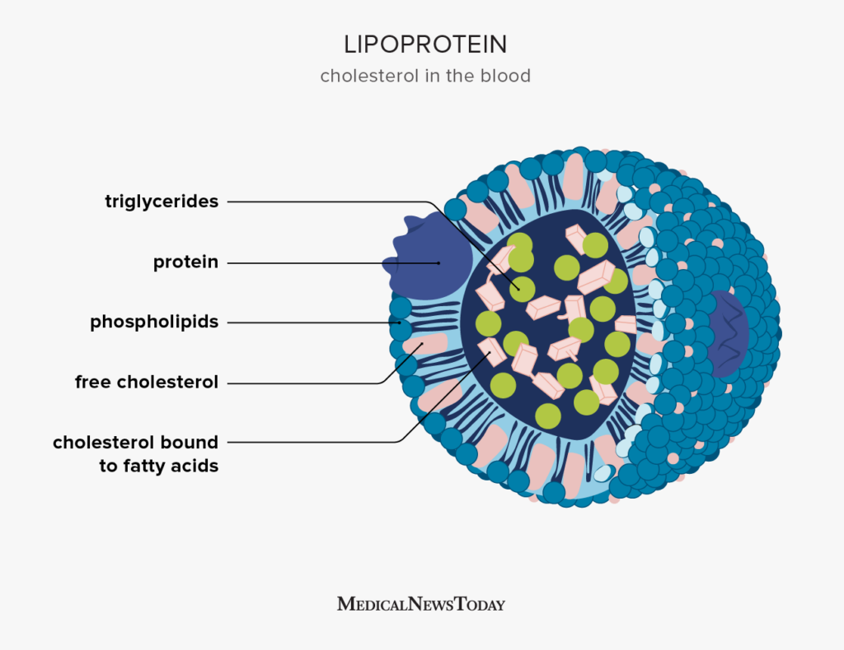
LO2

Slide 15
Lipoproteins particles are only stable if they maintain their spherical shape
this is dependent on the ratio of core to surface lipids. Thus, as the lipid from the hydrophobic core is removed and taken up by tissues, the surface coat must also be reduced.
Many components of the lipoprotein surface coat are free to transfer to different particles and to cell membranes.
However, core components can only be removed by special proteins such as lipases and transfer proteins.
LO2

Slide 16
LO2
Lipoproteins are classified by their buoyant density, which inversely reflects their size.
The greater the lipid:protein ratio, the larger their size and the lower the density.
They can be be separated from each other by electrophoresis or by ultracentrifugation.

Slide 17
Classes of Lipoproteins
LO2
Chylomicrons: are the largest and least dense lipoproteins that transport exogenous lipid from the intestine to other parts of the body.​
VLDL (Very-Low-Density Lipoproteins): Transport fats produced by the liver to tissues.​
LDL (Low-Density Lipoproteins): Deliver cholesterol to cells.​
HDL (High-Density Lipoproteins): Collect excess cholesterol from tissues and bring it back to the liver.
In addition, there are two remnants: Chylomicron remnants and remnants of VLDL.

Slide 18
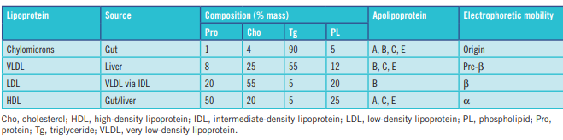
LO2

Slide 19
Chylomicrons
LO3
Dietary triacylglycerols cannot be absorbed directly and are hydrolyzed in the small intestine by the enzyme pancreatic lipase that releases fatty acids and glycerol.
The fatty acids enter the epithelial cells of the small intestine, then re-esterified back to triacylglycerols using glycerol phosphate produced from glucose metabolism.
The triacylglycerols are then packaged with other dietary lipids (e.g. cholesterol, fat soluble vitamins) into chylomicrons.
These chylomicrons are released into the blood stream via the lymphatic system and are carried to tissues, such as adipose tissue, which have the extracellular enzyme lipoprotein lipase. This enzyme hydrolyses TG to release F.A that enter the cell where they are converted to triacylglycerols for storage.

Slide 20
Very low-density lipoprotein(VLDL)
LO3
is a large TG-rich particle, synthesized by the liver.
after hepatic secretion into the circulation, it incorporates additional apoC from HDL particles.
Like chylomicrons, VLDL is hydrolysed by lipoprotein lipase in the peripheral tissues, albeit more slowly.
The resulting VLDL remnant or IDL contains cholesterol and triglyceride as well as apoB and apoE and is rapidly taken up by the liver or converted by the action of hepatic lipase to LDL by losing apoE and triglyceride.

Slide 21
Low-density lipoprotein (LDL)
LO3
is a small cholesterol-rich lipoprotein .
It represents about 70% of the total plasma cholesterol concentration.
It contains apoB100 which acts as ligand for its receptor.
tissues obtain the cholesterol they need from LDLs by the process of receptor-medicated endocytosis.
Cells requiring cholesterol synthesize specific LDL receptors that are exposed on the cell surface.

Slide 22
LO3
The LDL receptors recognize and bind to (Apo B100) on the surface of the LDL particles.
The LDL receptor with its bound LDL particle is taken into the cell by endocytosis , then its subjected to lysosomal digestion releasing cholesterol inside the cell.
The released cholesterol is used by cell or stored (as cholesterol- esters) .

Slide 23
LO3
All cells (except RBC ) are able to synthesize cholesterol from acetyl CoA and could satisfy their requirements by biosynthesis.
However, in practice all cells appear to prefer to take up pre-formed cholesterol circulating in plasma lipoproteins.
WHY?????

Slide 24
LO3
How does LDL differ from chylomicrons and VLDL in the metabolism ???

Slide 25
LO3
High-density lipoprotein (HDL)
It responsible for transport of cholesterol from non-hepatic cells to the liver.
The HDL is synthesized in both hepatic and intestinal cells and secreted from them as small, nascent HDL particles.
Many factors increase its synthesis like exercise , oestrogens , fibrates and statins.
Removal of HDL may occur by endocytosis, although there may be specific receptors ( murine class B type I scavenger receptor ) in liver and steroidogenic tissue ( adrenal glands, ovaries and testes ).
It is cardio protective
WHY????

Slide 26
Enzymes of lipoprotein metabolism

Slide 27
LO4
1-Lipoprotein Lipase
is the enzyme responsible for removing the core TG from chylomicrons and VLDLs.
It is found attached to the inner surface of capillaries in tissues such as adipose tissue and muscle.
Insulin increases the synthesis of the enzyme by tissues.
The enzyme hydrolyses triacylglycerols in lipoprotein particles, releasing fatty acids and glycerol.
The fatty acids are then taken up by tissues and the glycerol is transported to the liver.

Slide 28
LO4
2- Lecithin:Cholesterol Acyltransferase (LCAT):
is the enzyme responsible for the esterification of free cholesterol , by using fatty acid derived from lecithin.
It presents on HDL
is activated by apoA1 , the predominant apolipoprotein of HDL.
Most of the esterified cholesterol is transferred to LDL, VLDL and chylomicron remnants and thus ultimately reaches the liver while some may be stored within the core of the HDL particle and taken directly to the liver.

Slide 29
Whats the importance of esterification here????

Slide 30
LO4
The removal of core lipids from lipoprotein particles makes them unstable as the ratio of surface to core lipids increases. Stability can be restored if some of the surface lipid is converted to core lipid.
This is achieved by the enzyme LCAT which is important both in the formation of lipoprotein particles and in maintaining their structure.
Deficiency of the enzyme results in unstable lipoproteins of abnormal structure and a general failure in the lipid transport processes. Lipid deposits occur in many tissues and atherosclerosis is a serious problem

Slide 31
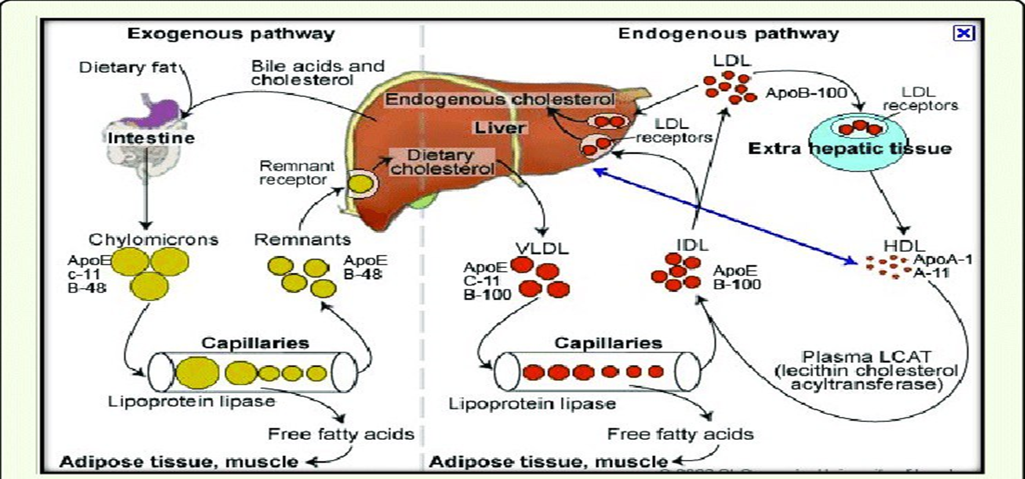
LO4

Slide 32
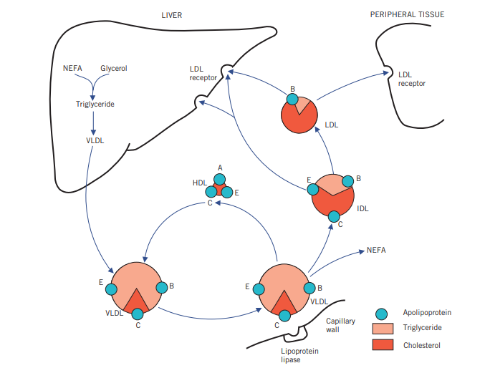
LO4
Endogenous pathway of lipid metabolism

Slide 33
?
Q: which lipoprotein is responsible for reverse cholesterol transport ?????

Slide 34
Dyslipoproteinaemia

Slide 35
Dyslipoproteinaemias refers to any defect in the metabolism of the plasma lipoproteins.
It may be:
secondary (acquired) as a result of diet ,drugs or an underlying disease such as diabetes.
primary (familial inborn error of lipoprotein metabolism)
LO5

Slide 36
LO5
Hyperlipoproteinemia
Referred to the raised levels of one or more of the plasma lipoproteins.
Classification of Hyperlipoproteinaemias:
The most widely used system is that devised by Fredrickson (also called the WHO system).
It is based on measurement of the fasting plasma concentrations of glucose, total cholesterol and TG in addition to examination of the results of plasma lipoprotein separation by electrophoresis.

Slide 37
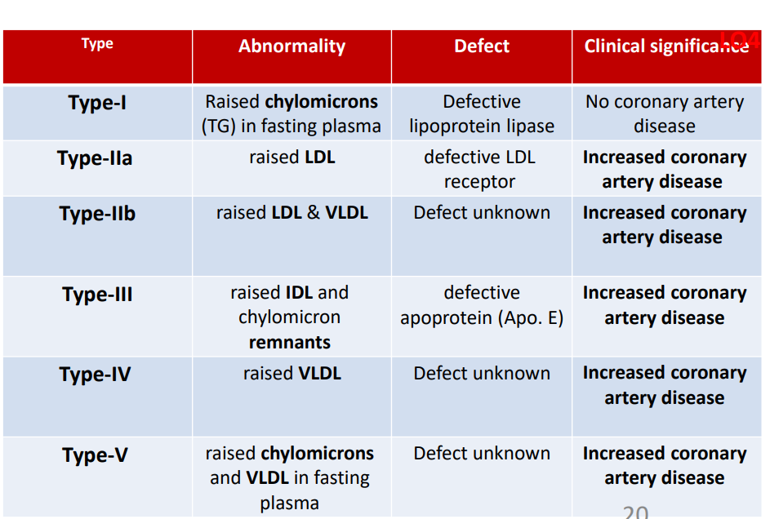
LO5
Fredrickson`s classification of hyperlipoproteinemia

Slide 38
Chylomicron syndrome:
LO5
Autosomal recessive
Affecting 1 in 1 000 000 people.
Familial lipoprotein lipase deficiency.
Fredrickson’s classificationtype I ,type V.
Presented as a child with abdominal pain (often with acute pancreatitis) is typical.
Lipid stigmata: eruptive xanthomata hepatospleno-megaly and lipaemia retinalis.
Gross elevation of plasma TG.

Slide 39
Whole blood of patient with lipoprotein
Lipase deficiency. Note chylomicron creamy appearance???

Slide 40
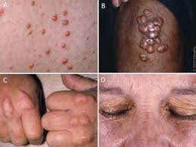
LO5
Lipaemi retinalis Eruptive xanthoma
13

Slide 41
Familial hypercholesterolaemia
LO5
Autosomal Dominant.
Homozygotes develop extensive atherosclerosis early in life
Fredrickson’s classification : type IIa.
there may be an absence (homozygous) or deficiency (heterozygous) of functional LDL receptors.
heterozygotes develop the condition later in life.
Severe hypercholesterolemia + relatively normal plasma TG.
14

Slide 42
Tendon xanthomata and Premature corneal arci are clinical signs of familial hypocholesteremia

Slide 43
Some important causes of secondary hyperlipidemia
LO5
Predominant hypercholesterolemia:
Hypothyroidism, Nephrotic syndrome ,Cholestasis, e.g. primary biliary cirrhosis
Predominant hypertriglyceridemia:
alcohol excess, Obesity, Diabetes mellitus, metabolic syndrome and Chronic kidney disease

Slide 44
Treatment of Hyperlipoproteinaemia
LO6
Lifestyle Modifications:
Dietary Changes
Eating a balanced diet low in saturated fats and cholesterol.​
Exercise
Regular physical activity helps manage weight and improve lipid profiles.​
Medications:
Statins:
Drugs that lower cholesterol levels by inhibiting its production in the liver.​
Fibrates
Medications that reduce triglyceride levels and increase HDL cholesterol
The bile salt sequestrants (e.g. cholestyramine) lower plasma cholesterol by increasing its disposal from the body (with bile)

Slide 45


